Slide 2
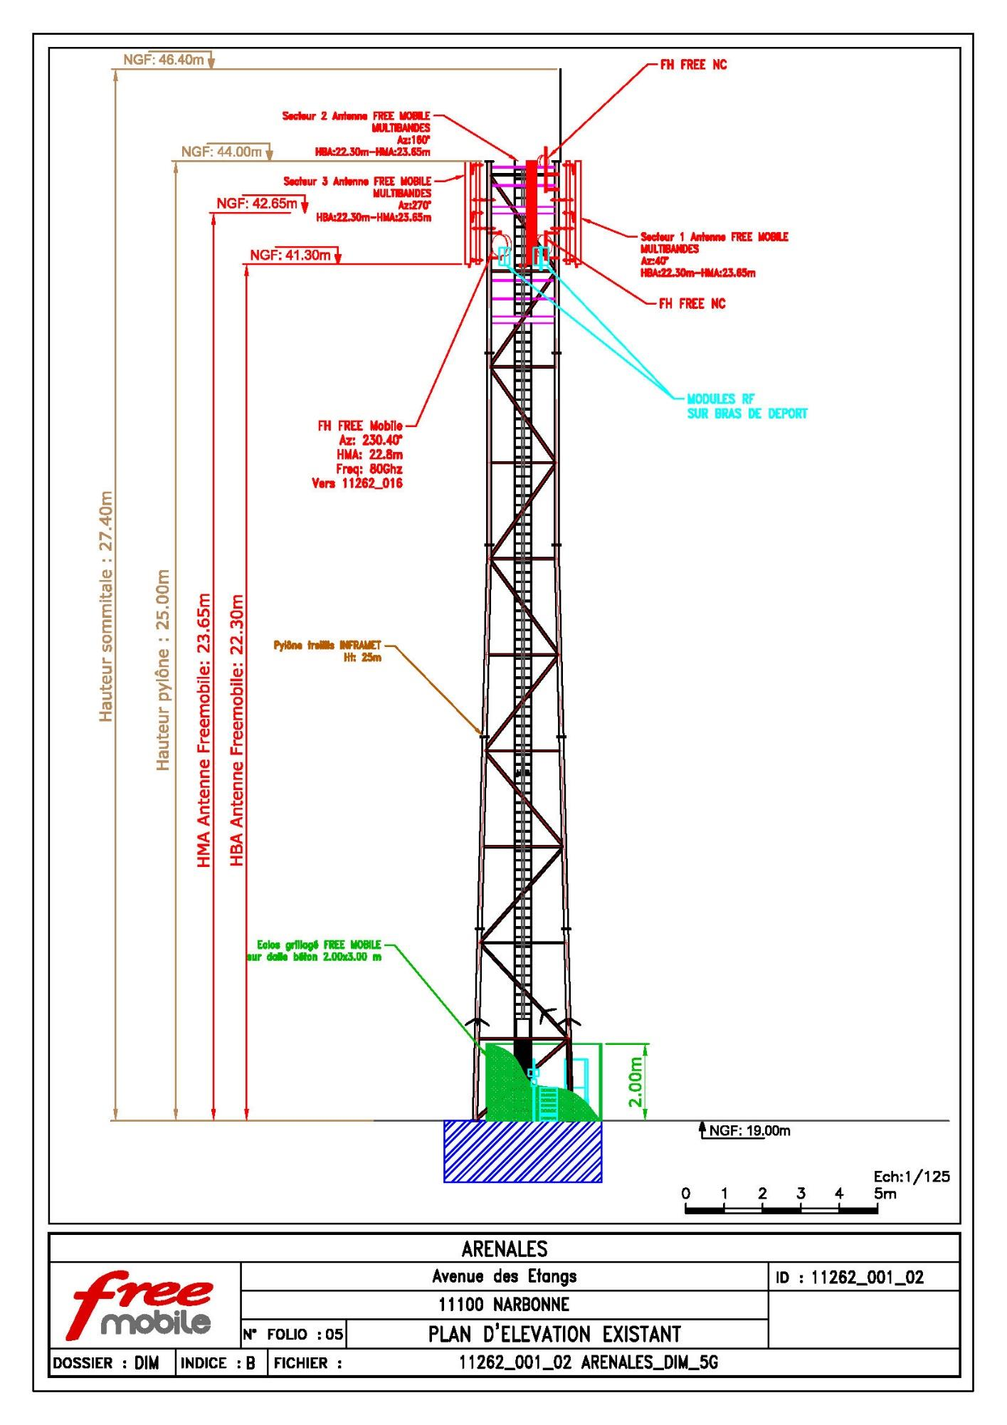
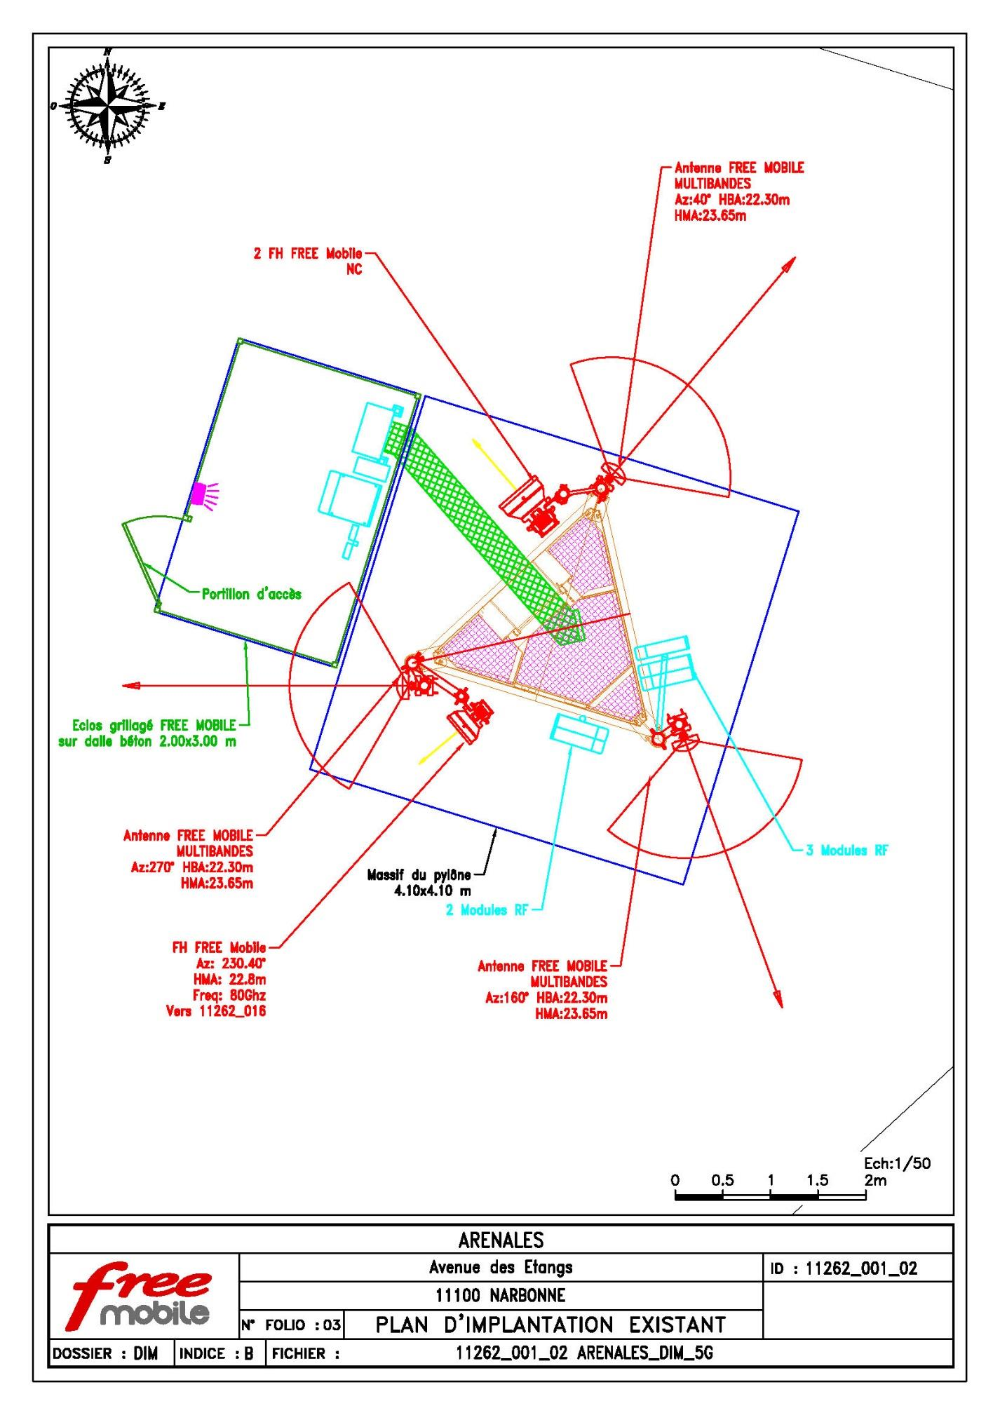

Slide 3
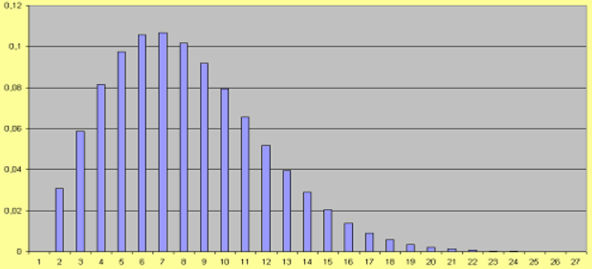

Slide 4
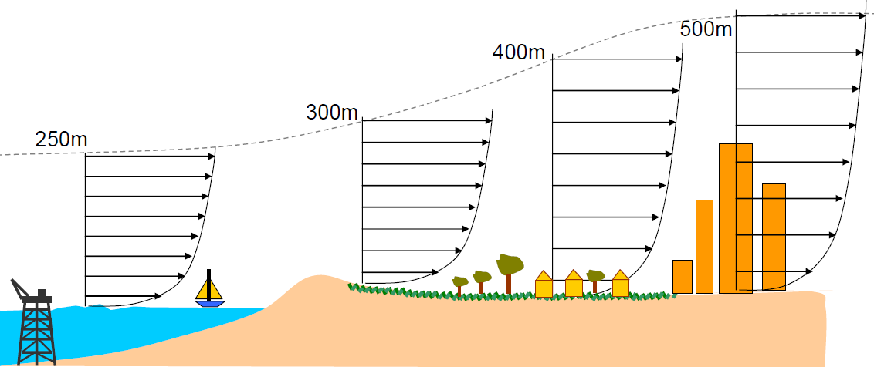
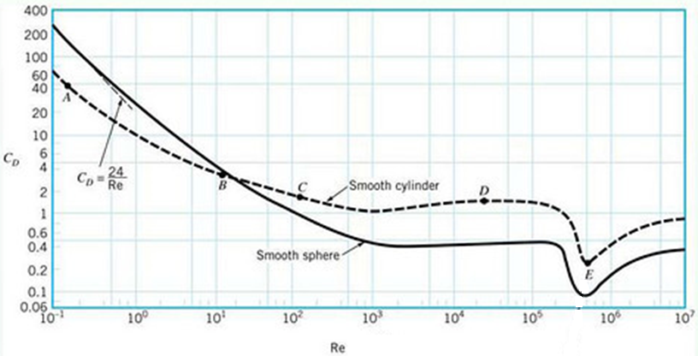
$$V\left(z\right)={\left(\frac{z}{z_{G}}\right)}^{α}V_{G}={\left(\frac{z}{z_{ref}}\right)}^{α}V_{ref}$$
Terrain | Rough sea | Grassland | Suburb | City centre
$$α$$ | 0.12 | 0.16 | 0.28 | 0.40
$z_{G}$ (m) | 250 | 300 | 400 | 500
$$R_{e}=\frac{uD}{ν}$$

